Slide 1
Innovation Design Process
FRC Team 7446

Slide 2
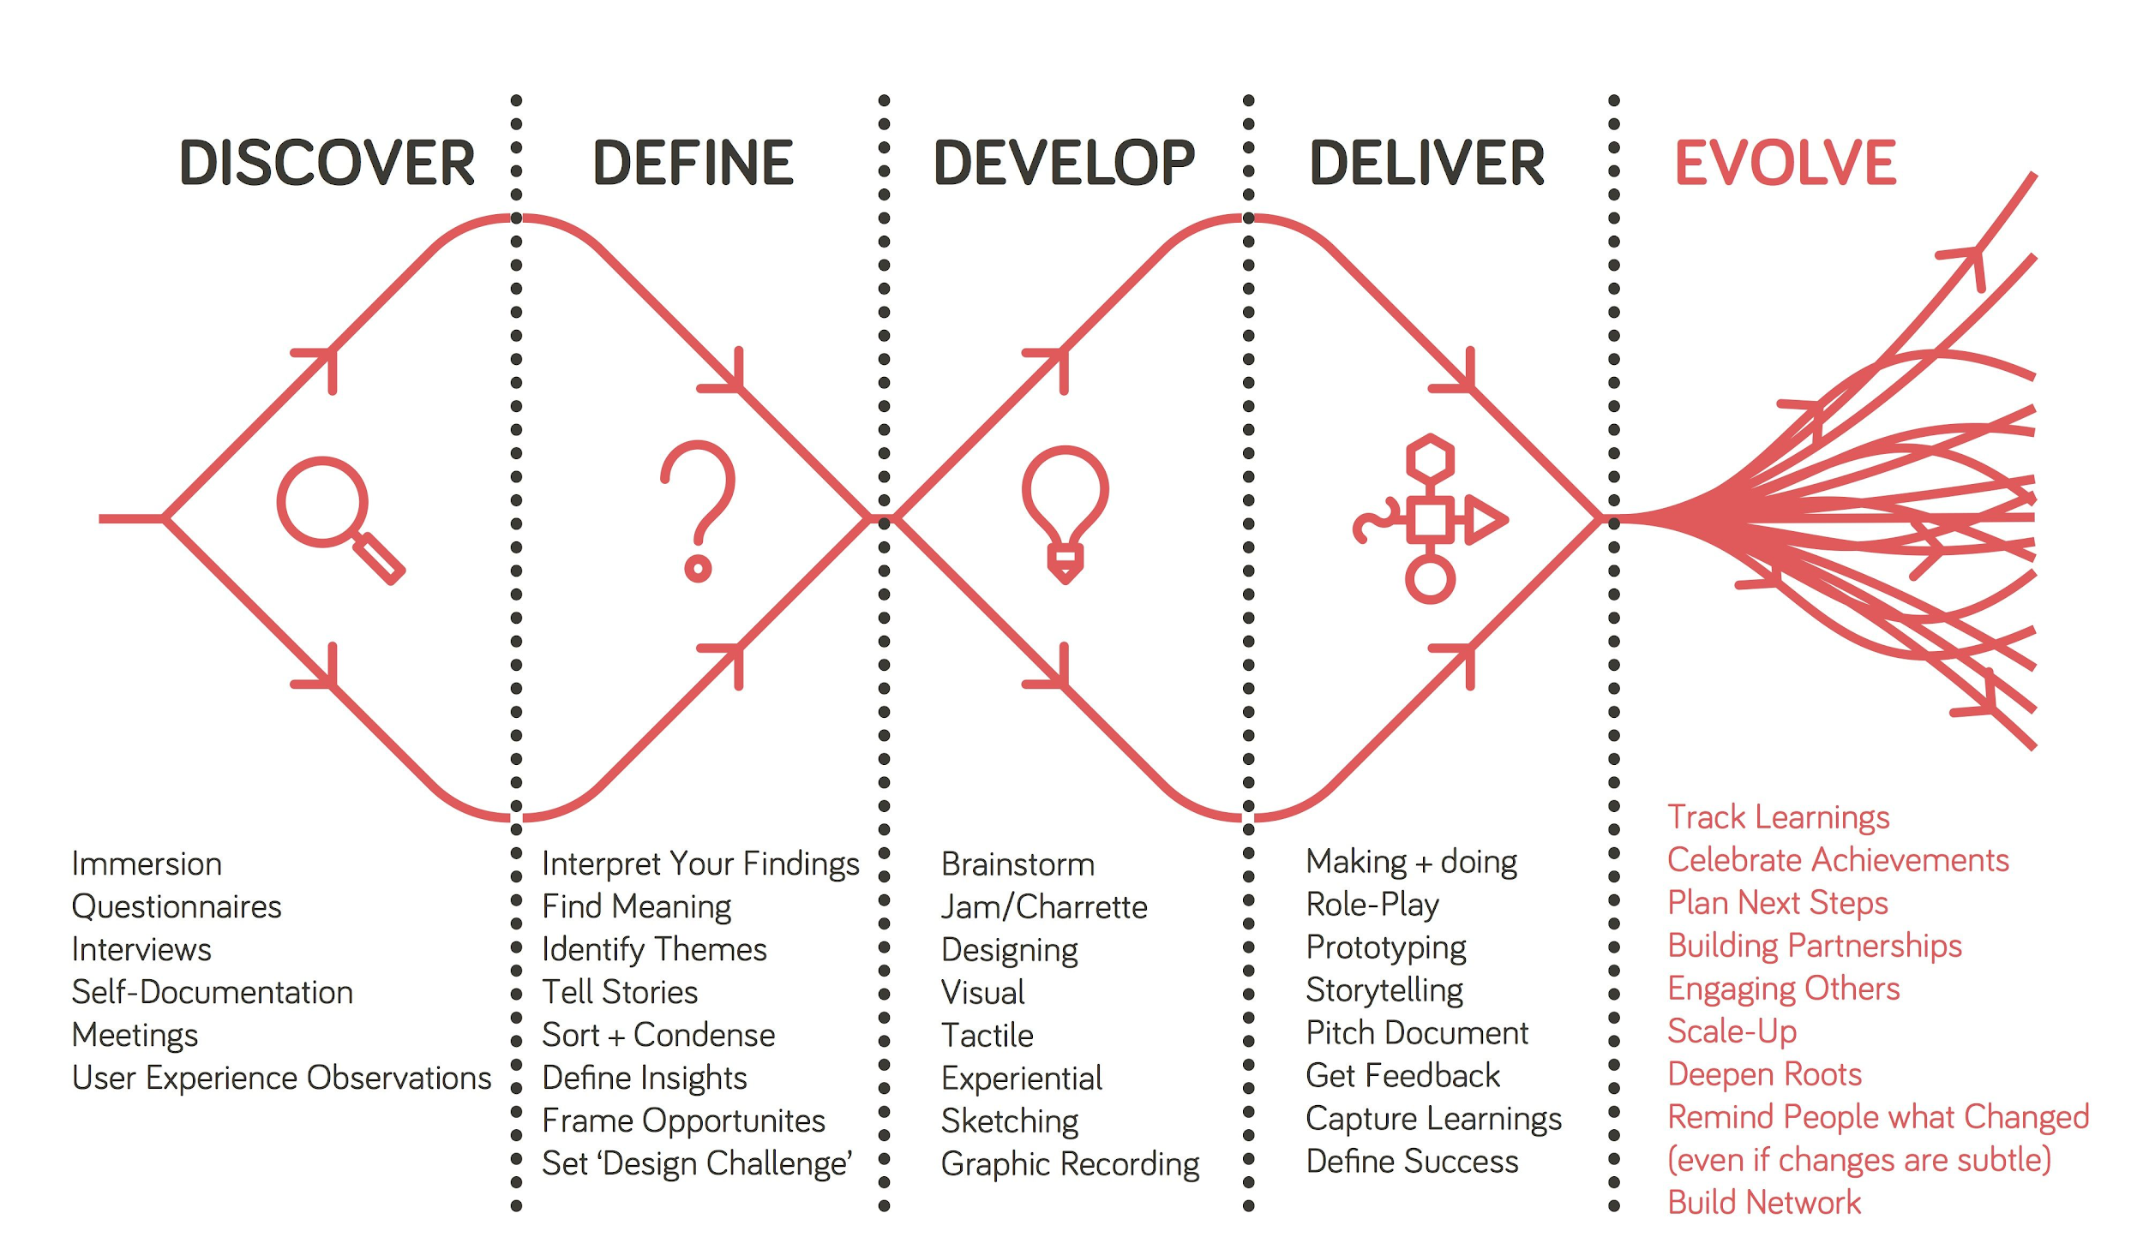

Slide 3

Discover: What is the Problem?
Main Focus: Veterans’ Mental and Physical Health
Main Questions:
What mental and/or physical health issues do veterans face?
Do Veterans have easy access to needed healthcare and therapy?
Do veterans have a proper feeling of belonging?
What personal experiences have veterans had issues with?
Are there outreach issues between the VA and veterans?

Slide 4
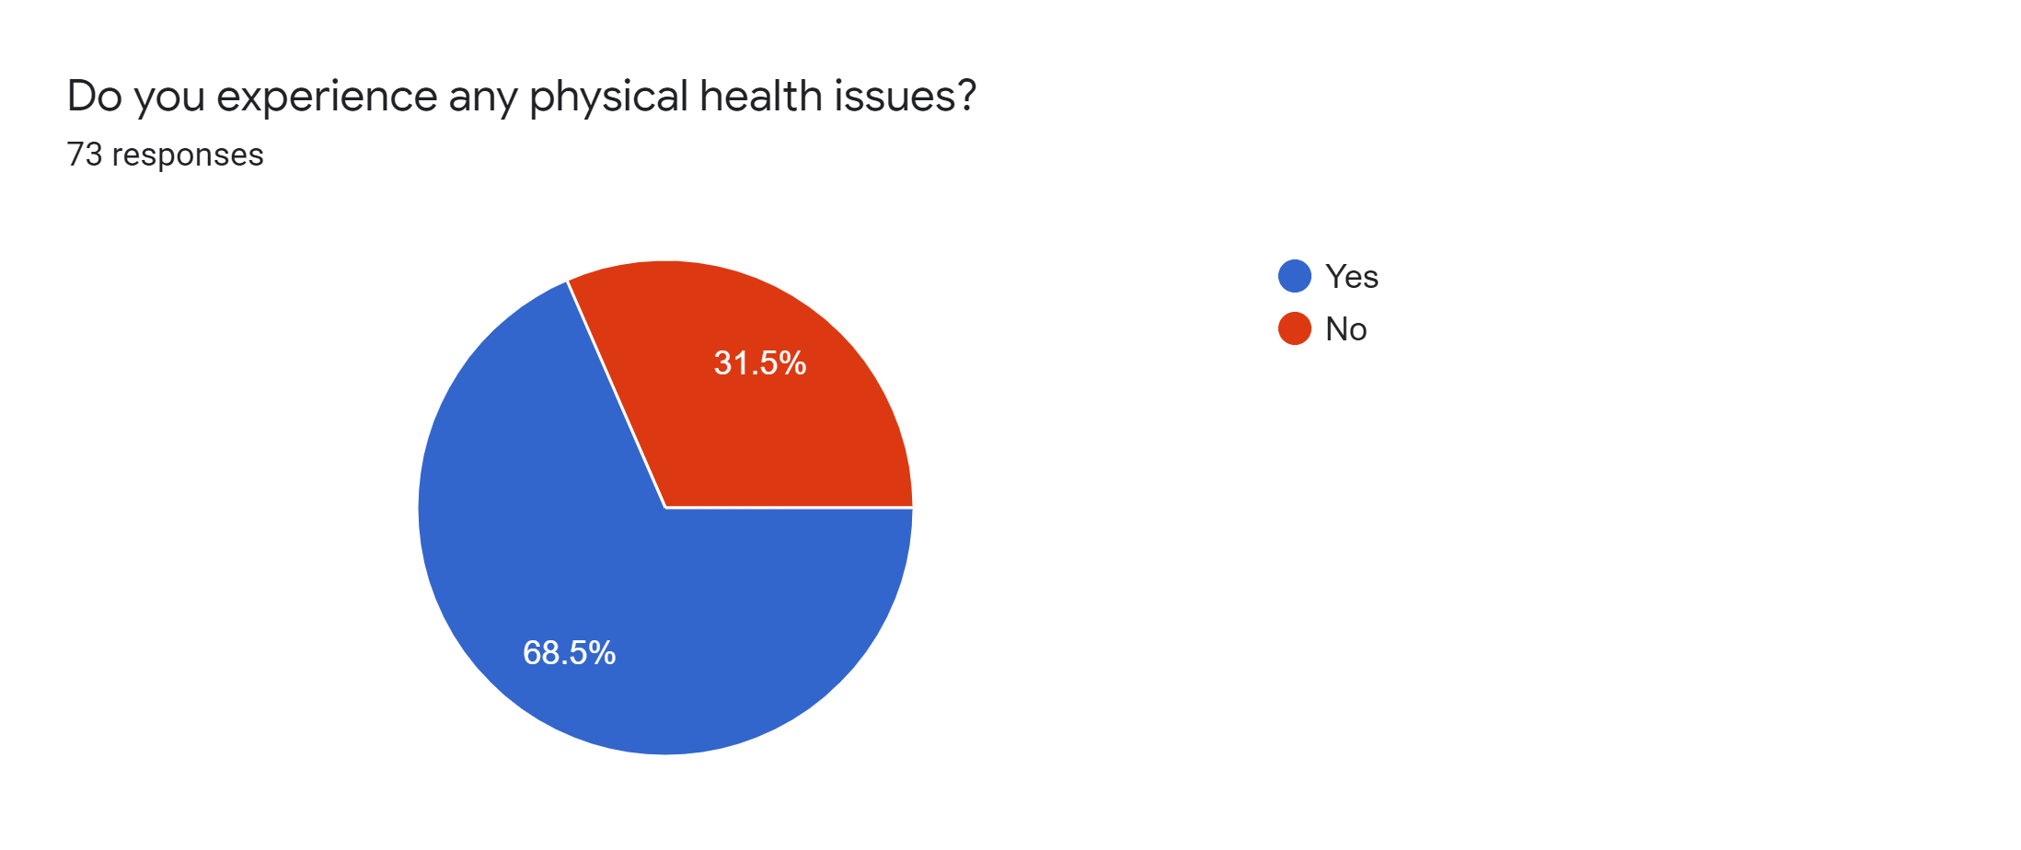
Survey Data

Slide 5
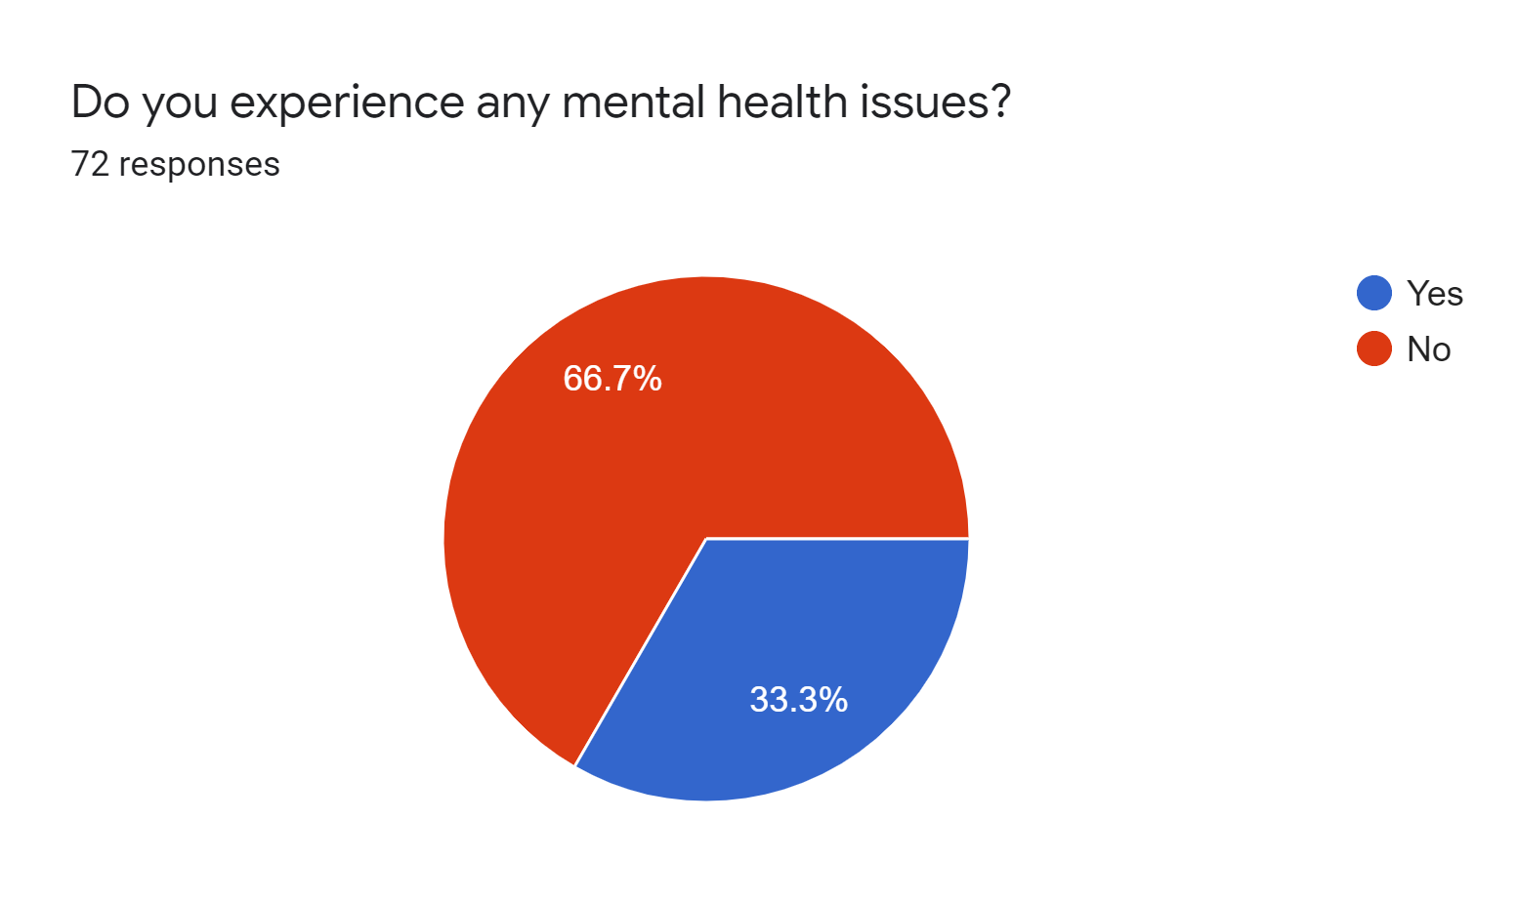

Slide 6
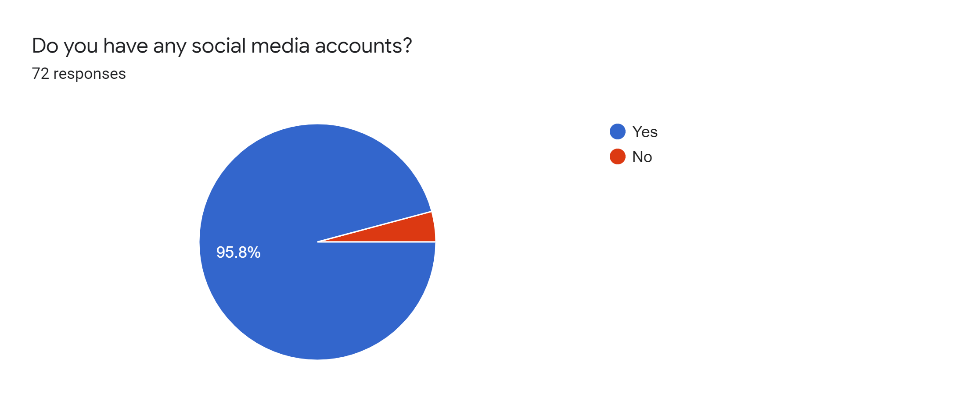

Slide 7


Slide 8
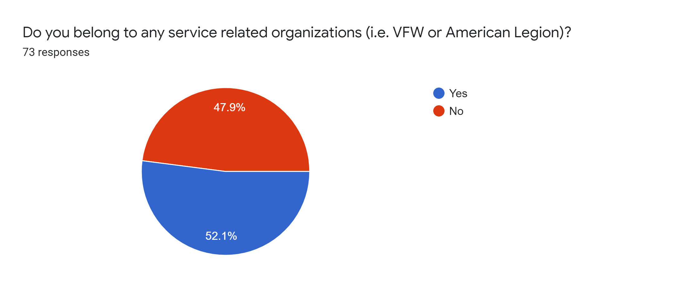

Slide 9
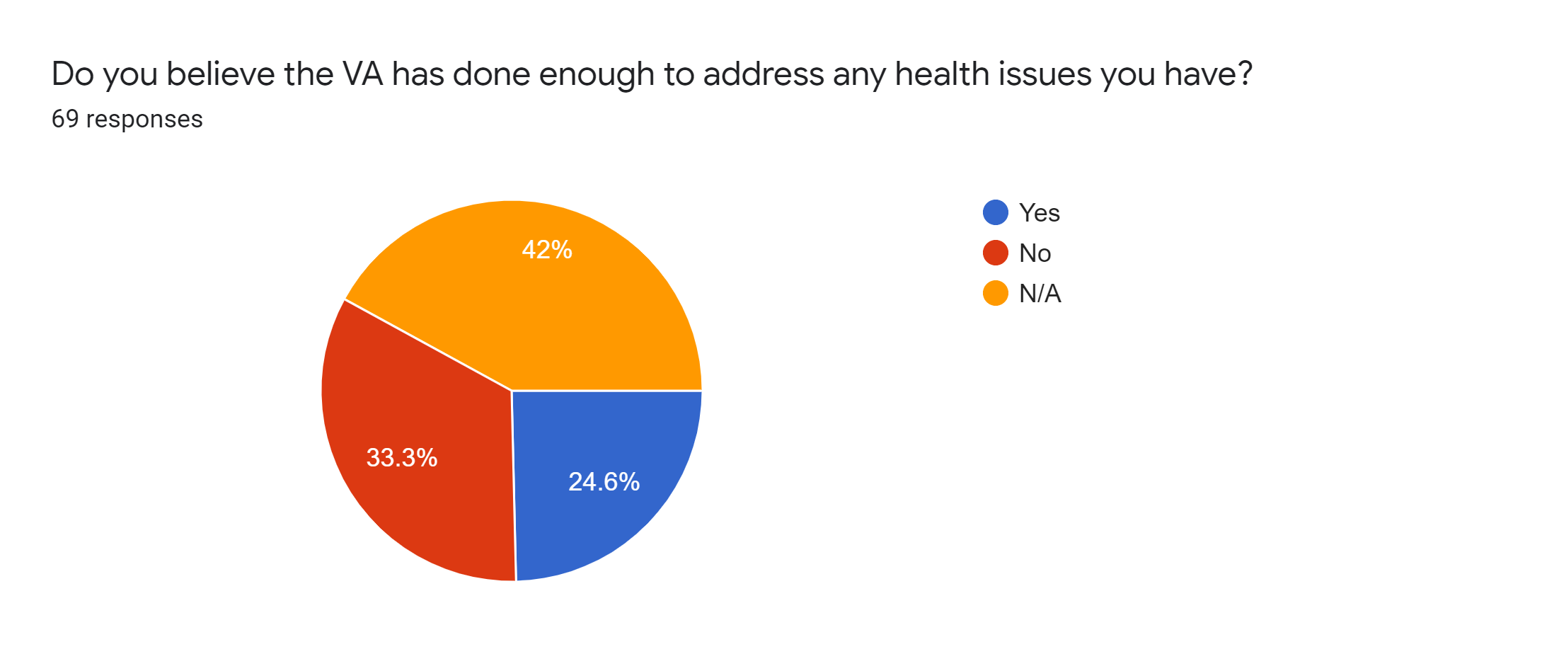

Slide 10
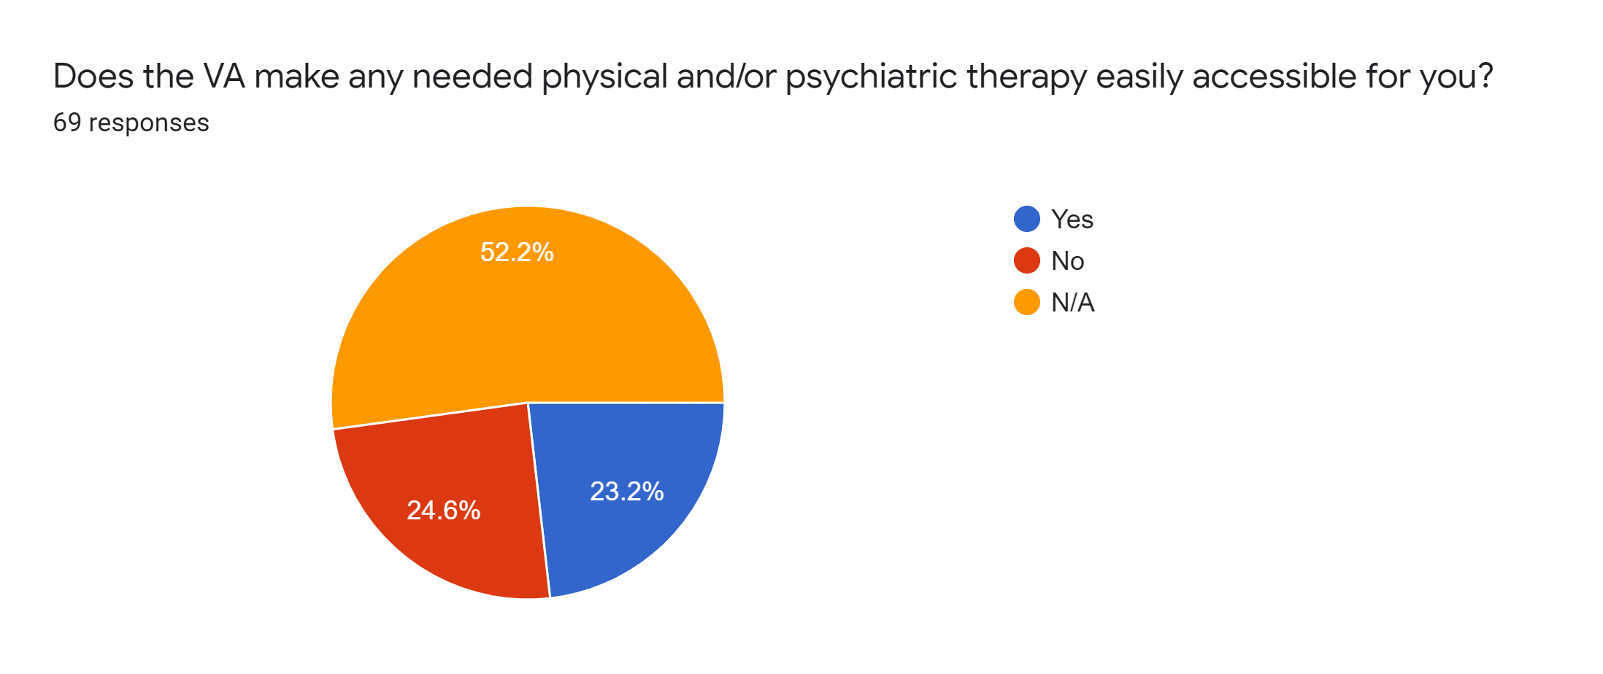

Slide 11
Reported Health Issues
Mental (27 Reported):
PTSD (11 reported)
Anxiety (9 reported)
Depression (11 reported)
Physical (50 responses):
Wide Range
Examples:
Knee Issues
Migraines
Back Issues
Blood Pressure
Etc.

Slide 12
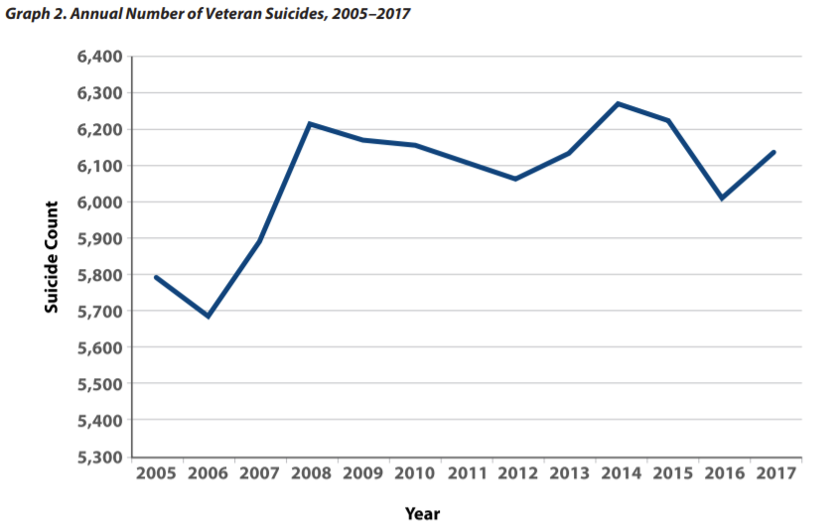
Experts and Reports
“Some Veterans report difficulty in transitioning to civilian positions.”
Social Connection: “Isolation has been shown to be a risk factor for suicide. Among VHA patients, suicide rates have been found to be highest among those who were divorced, widowed, or never married and lowest among those who married. Also, among VHA patients, suicide rates were elevated among individuals residing in rural areas.”
Health and Well-Being:
“VHA Veterans who died by suicide were more likely to have sleep disorders, traumatic brain injury, or a pain diagnosis.”
“Mental health diagnoses inpatient mental health care, prior suicide attempts, prior calls to the Veterans Crisis Line, and prior mental health treatment were also associated with greater likelihood of suicide.”
https://www.mentalhealth.va.gov/docs/data-sheets/2019/2019_National_Veteran_Suicide_Prevention_Annual_Report_508.pdf

Slide 13
What Issues are the VA Reporting?
Excessive and Contradictory Spending
Backlog of Benefit Claims
IT Challenges
Inadequate Staff Training
Untimely Health Care
“The total number of veterans enrolled in VA’s health care system rose from 7.9 million to over 9 million from FYs 2006 through 2017.”
https://www.cnbc.com/2018/05/28/va-veterans-affairs-history-setbacks-missteps.html
https://www.gao.gov/key_issues/managing_risks_improving_va_health_care/issue_summary

Slide 14
What Issues have Veterans had with the VA?
“I live 90 miles from VA Medical facility therefore do not utilize their services”
“Ability to make appointments or get evaluated for disability”
“Smug, unprofessional, if it’s not in your SRB then I don't have time for you.”
“Appointments in a timely manner.”
“Scheduling appointments, limited choices of meds.”
“Lack of respect from employees and some medical staff as well as unclear directions about their services and their actual care in general.”
“Hard to get an appointment. Doctor wants to get you out of their office. Just throw meds at every problem.”
“I’ve tried to get counseling for mental health for over 6 months now and still haven’t had an appointment.”
“Getting treatment in a timely manner.”

Slide 15
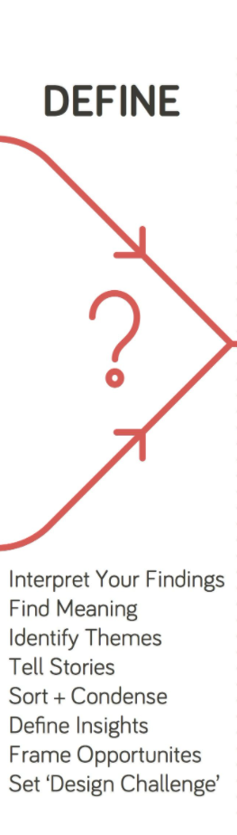
Define: What does the data mean?

Slide 16
Main Themes of Issues
Belongingness
Access
Communication
Education

Slide 17
More Focused Issue?
Veteran’s poor access to:
Health and claims education
Communication with VA
Healthcare Needs
A Sense of Belongingness

Slide 18
What We Need to Promote
Motivate Exercise and Mental/Physical Therapy
Increase Communication Between Vets and Vets
Increase Communication Between Vets and VA/Doctors
Increase Ease of Access to Health Education
Mitigate Burdens on VA
Become a stepping stone before VA
E.g. have quality help for health issues such as PTSD or addiction before vets seek claims and help from VA

Slide 19

Develop: Possible Solutions?

Slide 20
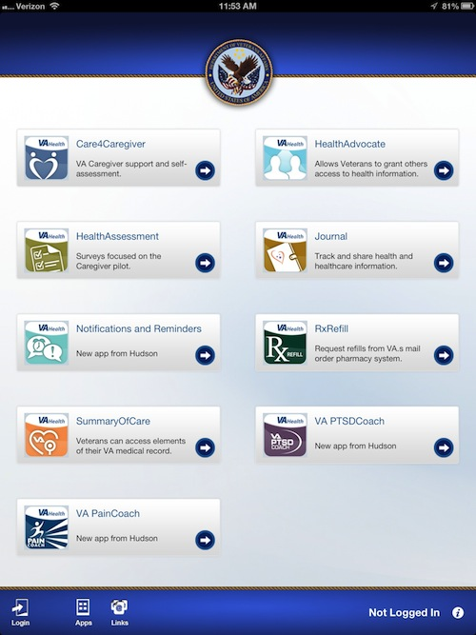
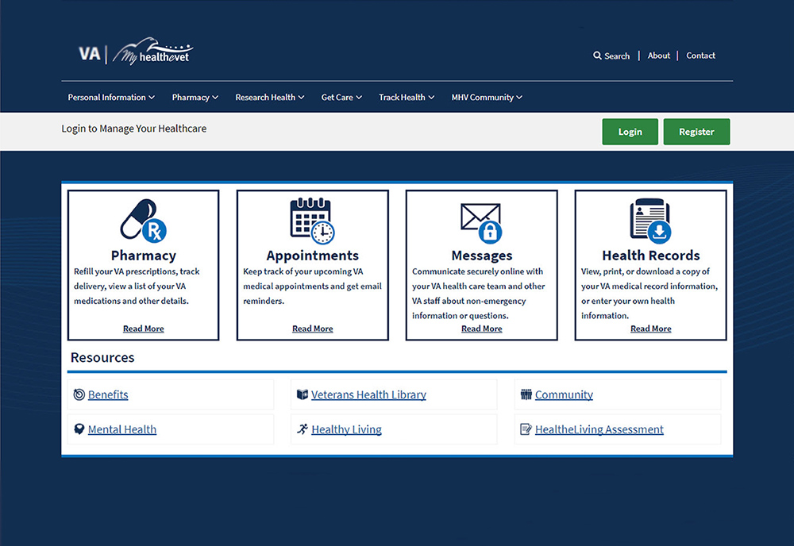
Current Workarounds

Slide 21
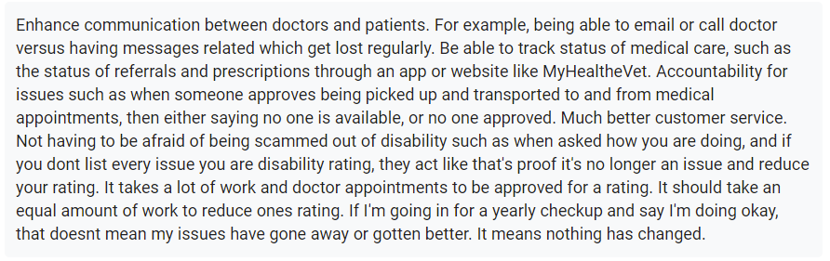
Veterans’ Ideas
“Reaching out more to Veteran to make sure they being looked after like they should be.”
“Stop denying your claim when you have documentation to prove your condition”
“Informing veterans of benefits. Tracking veterans with psychological issues.”
“Many veterans are unaware of the benefits they may be eligible for, or how to effectively apply for benefits. Many veterans rely on the help of external veteran organizations to help navigate the process”

Slide 22
Our Ideas

Slide 23
Apps and Website

Slide 24
Motivate Exercise and Mental/Physical Health Questions
1st: What motivates people to exercise, specifically veterans, and how can we tap into that?
2nd: How can we address the age differences in physical ability?
3rd: How can we address physical impairments with assistive technology?

Slide 25

Deliver: What is the Best Solution?

Slide 26
Prototypes

Slide 27
Business Model
Main Source of Revenue?

Slide 28

Evolve: Furthering Our Impact

Slide 29
Building a Customer Base

Slide 30
Partnerships

Slide 31
Tracking Impact

Slide 32
Testing

Slide 33
Future Plans

